Slide 1


d
Almaz Sadenov
26 Oct 2021

Slide 2

Outline
Executive Summary
Introduction
Methodology
Results
Conclusion
Appendix

Slide 3
Executive Summary
Summary of methodologies
Summary of all results

Slide 4
Introduction
Project Background
SpaceX advertises Falcon 9 rocket launches on its website with a cost of 62 million dollars; other providers cost upward of 165 million dollars each, much of the savings is because
SpaceX can reuse the first stage. Therefore if we can determine if the first stage will land, we can determine the cost of a launch.
In this capstone, we will predict if the Falcon 9 first stage will land successfully.

Slide 5


Slide 6
Methodology
Executive Summary
Data collection methodology:
Data was collected and checked that is in the correct format from an API.
Also launch data extracted from HTML table from Wikipedia
Perform data wrangling
Features created, missing values checked, visualized through pandas dataframe
Perform exploratory data analysis (EDA) using visualization and SQL
Perform interactive visual analytics using Folium and Plotly Dash
Perform predictive analysis using classification models

Slide 7
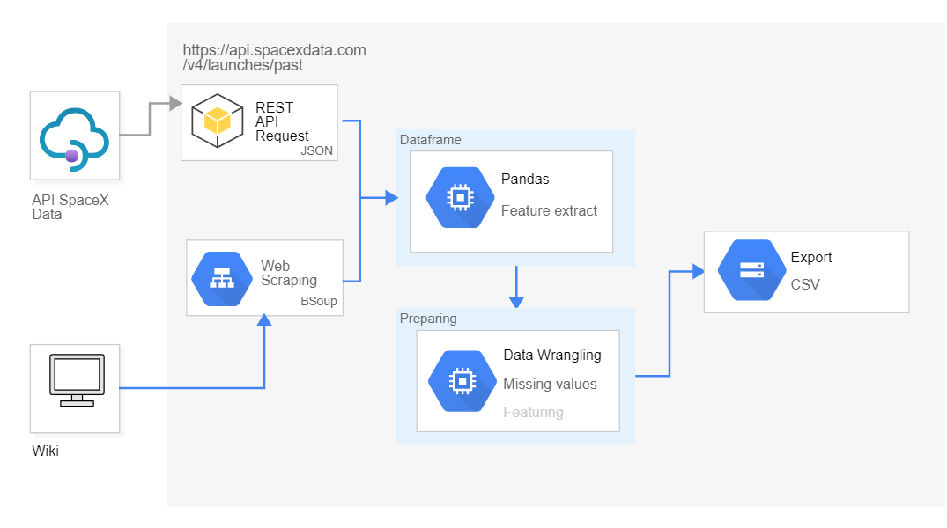
Data Collection

Slide 8
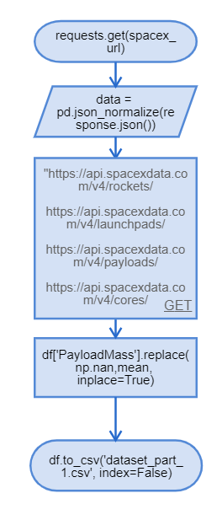
Data Collection – SpaceX API
Data collection with SpaceX REST calls
GitHub URL of the completed SpaceX API calls notebook
https://github.com/alm4z/ibm-ds-capstone/blob/8cdab60ff7a87ed2bcf4b462053d98607dbf94fe/Week%201/Data%20Collection%20API.ipynb
Decode the response content as a Json using json() and turn it into a Pandas dataframe using.json_normalize()
We will now use the API again to get information about the launches using the IDs given for each launch. Specifically we will be using columns
Rocket
Payloads,
Launchpad,
Cores
The mean and the .replace() function to replace `np.nan` values in the data with the mean you calculated.

Slide 9
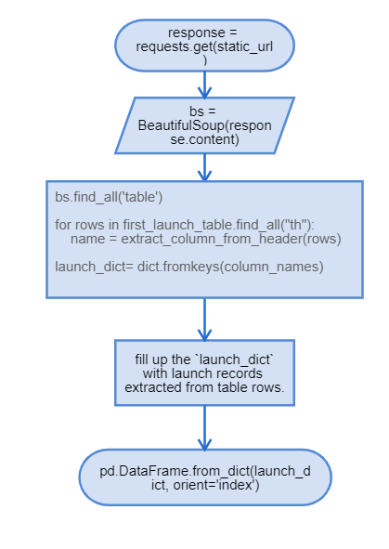
Data Collection – Scraping
Data collection with Web Scraping
GitHub URL of the completed Web Scraping notebook
https://github.com/alm4z/ibm-ds-capstone/blob/8cdab60ff7a87ed2bcf4b462053d98607dbf94fe/Week%201/Data%20Collection%20with%20Web%20Scraping.ipynb
Request the HTML page from the above URL and get a `response` object
Use BeautifulSoup() to create a BeautifulSoup
object from a response text content
Iterate each required html element and apply the provided extract_data() to get a value
Create dataframe and export it to a CSV.

Slide 10
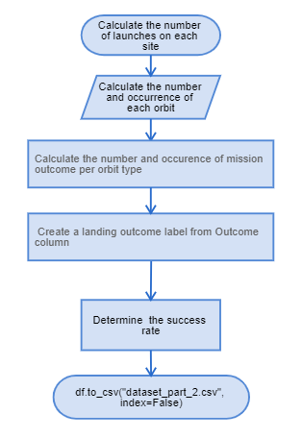
Data Wrangling
Data was processed using pandas dataframe features
Data wrangling process contains 5 steps for data understanding
GitHub URL of completed data wrangling related notebook
https://github.com/alm4z/ibm-ds-capstone/blob/8cdab60ff7a87ed2bcf4b462053d98607dbf94fe/Week%202/EDA.ipynb

Slide 11
EDA with Data Visualization
Scatter Point Charts:
The relationship between Flight Number and Launch Site
The relationship between Payload and Launch Site
The relationship between Payload and Orbit type
Bar Chart
The relationship between success rate of each orbit type
Line Chart
The launch success yearly trend¶
https://github.com/alm4z/ibm-ds-capstone/blob/8cdab60ff7a87ed2bcf4b462053d98607dbf94fe/Week%202/EDA%20with%20Data%20Visualization.ipynb

Slide 12
EDA with SQL
Performed SQL queries:
The names of the unique launch sites in the space mission
5 records where launch sites begin with the string 'CCA'
Average payload mass carried by booster version F9 v1.1
List of the first successful landing outcome in ground pad was acheived.
List of the names of the boosters which have success in drone ship and have payload mass greater than 4000 but less than 6000
List of the total number of successful and failure mission outcomes
List of the names of the booster_versions which have carried the maximum payload mass. Use a subquery
List of the failed landing_outcomes in drone ship, their booster versions, and launch site names for in year 2015
Ranked count of landing outcomes (such as Failure (drone ship) or Success (ground pad)) between the date 2010-06-04 and 2017-03-20, in descending order
https://github.com/alm4z/ibm-ds-capstone/blob/8cdab60ff7a87ed2bcf4b462053d98607dbf94fe/Week%202/EDA%20with%20SQL.ipynb

Slide 13
Build an Interactive Map with Folium
Next Folium maps were generated:
All launch sites were marked on a map¶
The success/failed launches were marked for each site on the map
The distances between a launch site to its proximities¶
These maps helped to understand distance relationship between launches
https://github.com/alm4z/ibm-ds-capstone/blob/8cdab60ff7a87ed2bcf4b462053d98607dbf94fe/Week%203/Interactive%20Visual%20Analytics%20with%20Folium%20lab.ipynb

Slide 14
Build a Dashboard with Plotly Dash
Next elements and functions were coded:
Dropdown list to enable Launch Site selection
Pie chart to show the total successful launches count for all sites
Slider to select payload range
Scatter chart for success payload
Callback function for `site-dropdown` as input, `success-pie-chart` as output
Callback function for `site-dropdown` and `payload-slider` as inputs, `success-payload-scatter-chart` as output
Interactive dash helps to understand relationship between payload and success launches count in different circumstances
https://github.com/alm4z/ibm-ds-capstone/blob/8cdab60ff7a87ed2bcf4b462053d98607dbf94fe/Week%203/spacex_dash_app.py

Slide 15
Predictive Analysis (Classification)
Performed exploratory Data Analysis and determined Training Labels
Created a column for the class
Standardized the data
Splited into training data and test data
Finded best Hyperparameter for SVM, Classification Trees and Logistic Regression
Selected the method performs best using test data
https://github.com/alm4z/ibm-ds-capstone/blob/8cdab60ff7a87ed2bcf4b462053d98607dbf94fe/Week%204/Machine%20Learning%20Prediction.ipynb

Slide 16
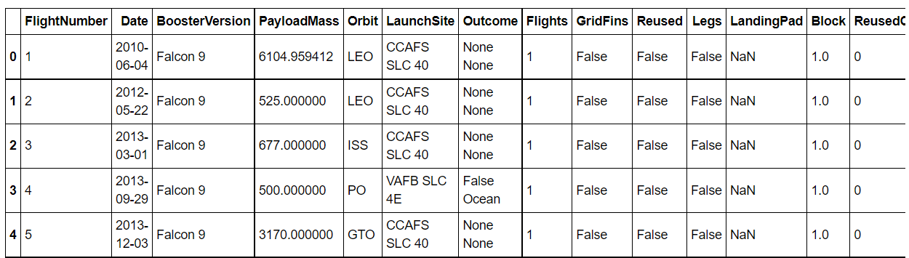
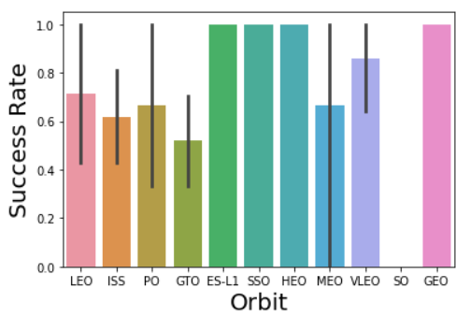
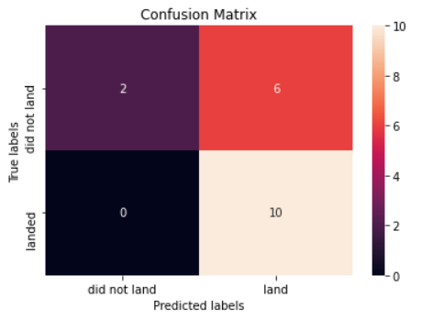
Results

Slide 17


Slide 18
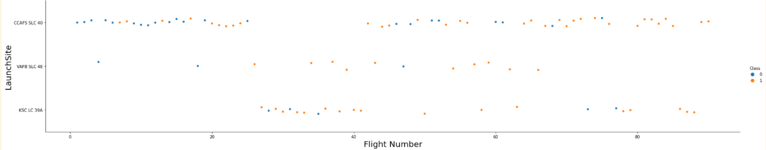
Flight Number vs. Launch Site

Slide 19
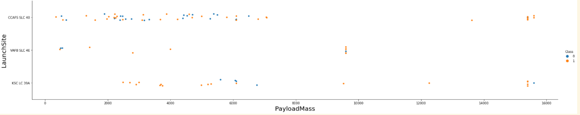
Payload vs. Launch Site

Slide 20
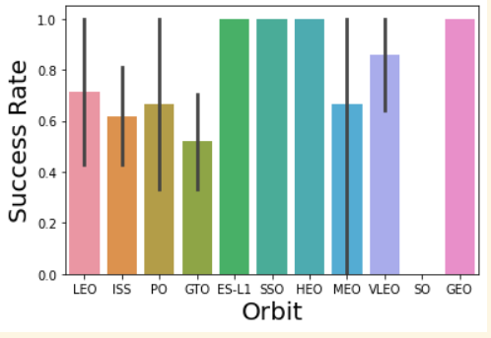
Success Rate vs. Orbit Type

Slide 21
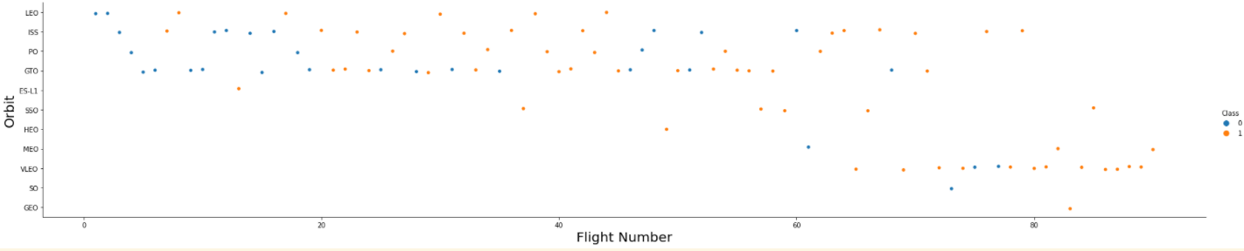
Flight Number vs. Orbit Type

Slide 22
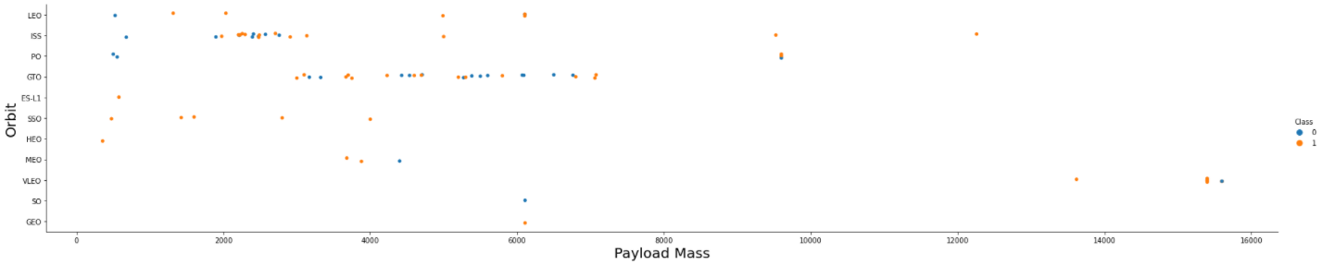
Payload vs. Orbit Type

Slide 23
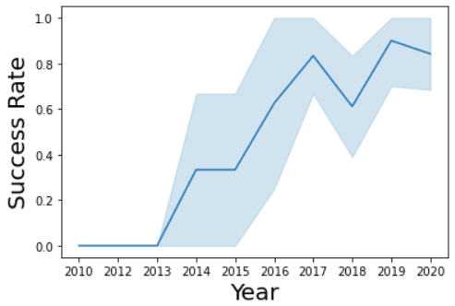
Launch Success Yearly Trend

Slide 24
All Launch Site Names
Find the names of the unique launch sites
Present your query result with a short explanation here

Slide 25
Launch Site Names Begin with 'CCA'
Find 5 records where launch sites begin with `CCA`
Present your query result with a short explanation here

Slide 26
Total Payload Mass
Calculate the total payload carried by boosters from NASA
Present your query result with a short explanation here

Slide 27
Average Payload Mass by F9 v1.1
Calculate the average payload mass carried by booster version F9 v1.1
Present your query result with a short explanation here

Slide 28
First Successful Ground Landing Date
Find the dates of the first successful landing outcome on ground pad
Present your query result with a short explanation here

Slide 29
Successful Drone Ship Landing with Payload between 4000 and 6000
List the names of boosters which have successfully landed on drone ship and had payload mass greater than 4000 but less than 6000
Present your query result with a short explanation here

Slide 30
Total Number of Successful and Failure Mission Outcomes
Calculate the total number of successful and failure mission outcomes
Present your query result with a short explanation here

Slide 31
Boosters Carried Maximum Payload
List the names of the booster which have carried the maximum payload mass
Present your query result with a short explanation here

Slide 32
2015 Launch Records
List the failed landing_outcomes in drone ship, their booster versions, and launch site names for in year 2015
Present your query result with a short explanation here

Slide 33
Rank Landing Outcomes Between 2010-06-04 and 2017-03-20
Rank the count of landing outcomes (such as Failure (drone ship) or Success (ground pad)) between the date 2010-06-04 and 2017-03-20, in descending order
Present your query result with a short explanation here

Slide 34


Slide 35
<Folium Map Screenshot 1>
Replace <Folium map screenshot 1> title with an appropriate title
Explore the generated folium map and make a proper screenshot to include all launch sites’ location markers on a global map
Explain the important elements and findings on the screenshot

Slide 36
<Folium Map Screenshot 2>
Replace <Folium map screenshot 2> title with an appropriate title
Explore the folium map and make a proper screenshot to show the color-labeled launch outcomes on the map
Explain the important elements and findings on the screenshot

Slide 37
<Folium Map Screenshot 3>
Replace <Folium map screenshot 3> title with an appropriate title
Explore the generated folium map and show the screenshot of a selected launch site to its proximities such as railway, highway, coastline, with distance calculated and displayed
Explain the important elements and findings on the screenshot

Slide 38


Slide 39
<Dashboard Screenshot 1>
Replace <Dashboard screenshot 1> title with an appropriate title
Show the screenshot of launch success count for all sites, in a piechart
Explain the important elements and findings on the screenshot

Slide 40
<Dashboard Screenshot 2>
Replace <Dashboard screenshot 2> title with an appropriate title
Show the screenshot of the piechart for the launch site with highest launch success ratio
Explain the important elements and findings on the screenshot

Slide 41
<Dashboard Screenshot 3>
Replace <Dashboard screenshot 3> title with an appropriate title
Show screenshots of Payload vs. Launch Outcome scatter plot for all sites, with different payload selected in the range slider
Explain the important elements and findings on the screenshot, such as which payload range or booster version have the largest success rate, etc.

Slide 42


Slide 43
Classification Accuracy
Visualize the built model accuracy for all built classification models, in a bar chart
Find which model has the highest classification accuracy

Slide 44
Confusion Matrix
Show the confusion matrix of the best performing model with an explanation

Slide 45
Conclusions
Point 1
Point 2
Point 3
Point 4
…

Slide 46
Appendix
Include any relevant assets like Python code snippets, SQL queries, charts, Notebook outputs, or data sets that you may have created during this project

Slide 47


